Slide 1


Slide 2


JS in the olden times
That which sparked the revolution
Webpack: what is it and why do we want it
Setup for the examples
Example 1 ES6 transpilation, bundling and npm scripts
Example 2 CSS and HTML loaders, webpack-dev-server
Example 3 Sourcemaps and modules
Example 4 Linting with ESLint and testing with Jest
Other cool features

Slide 3



Javascript in the olden times
Not that old, really, you can ask me about the truly olden times over a pizza later
Notes:
- Growth of media consumption in mobile is staggering
- Growth of hours in social media is increasing
- Mobile ads and growing exponentially

Slide 4

But, what is Node.js?

Slide 5
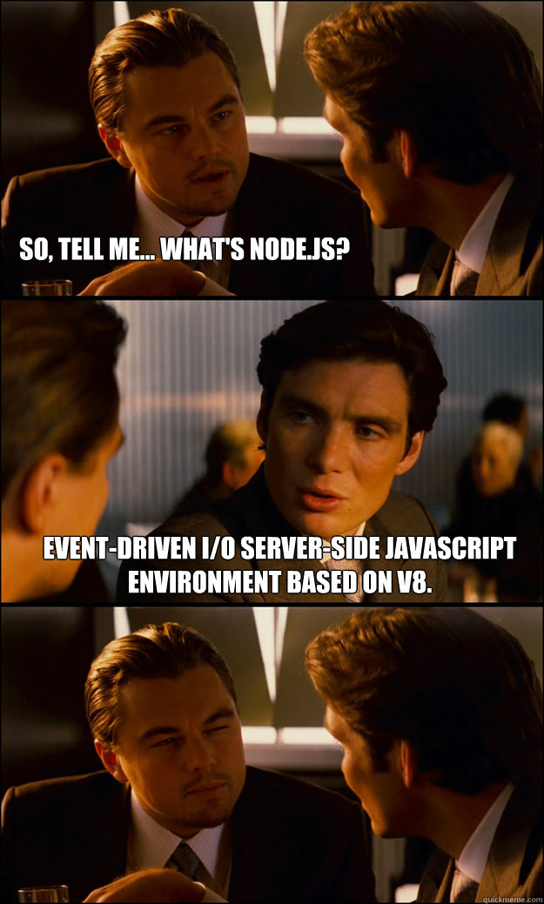

Slide 6
Node.js means javascript on the server
It’s single threaded and runs on the V8
V8 is Google's open source high-performance JavaScript engine
You can use Node to run javascript on your local machine outside the browser
Node has been leveraged creating a new set of development tools to improve the workflow, the most relevant of them being… webpack

Slide 7

Webpack is a module bundler for modern JavaScript applications. When webpack processes your application, it recursively builds a dependency graph that includes every module your application needs, then packages all of those modules into a small number of bundles - often only one - to be loaded by the browser.
Inintelligible explanation, webpackjs.org

Slide 8
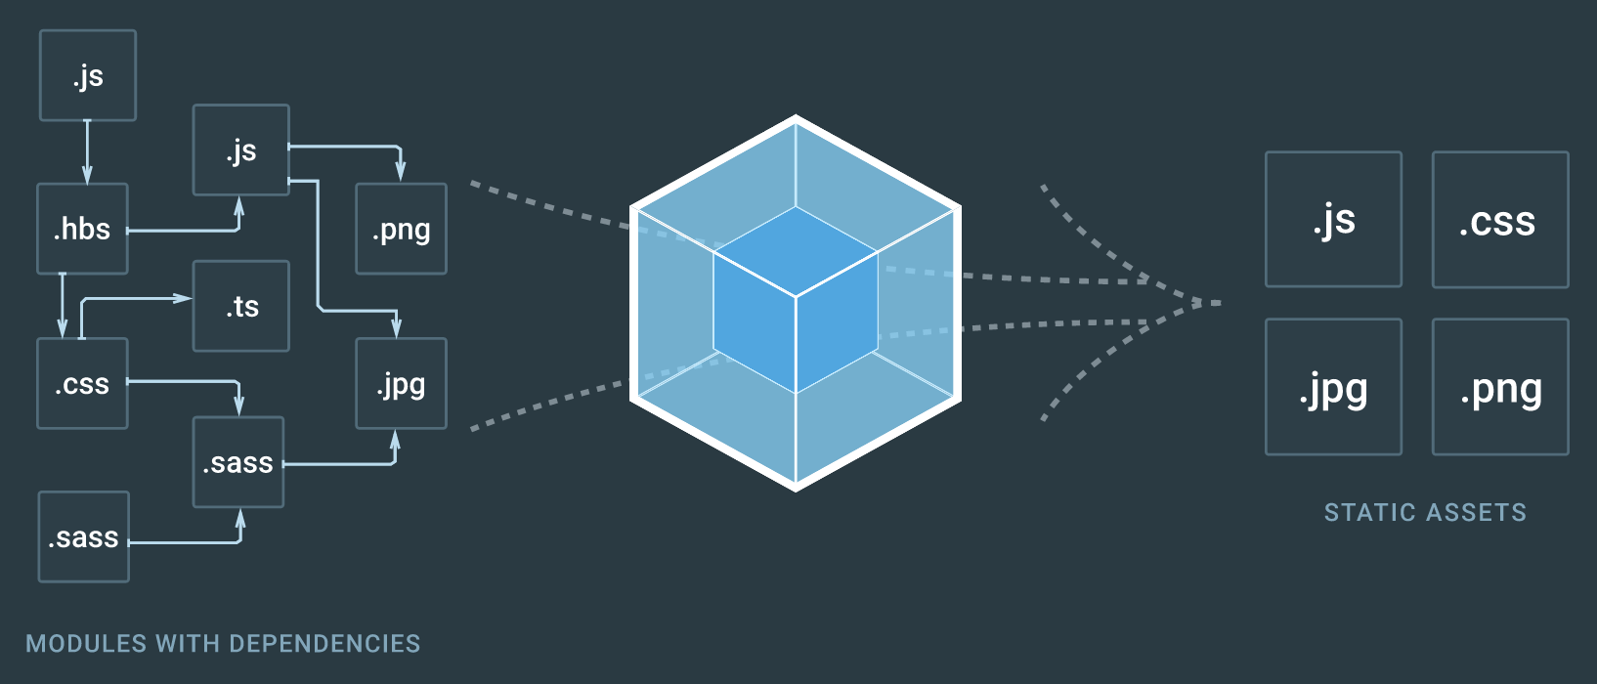

So, webpack, what it really does?

Slide 9
Setup for the examples
You should already have:
Node.js installed (includes NPM)
Cloned the repository for this session
https://github.com/ernifrontendcommunity/webpack-2-workshop-material.git

Slide 10
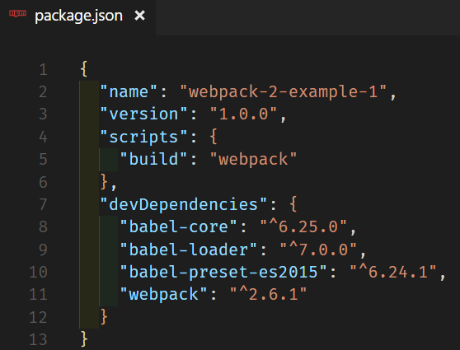
Example 1
First we have to specify all the dependencies.
Scripts
Transpilers
Webpack

Slide 11
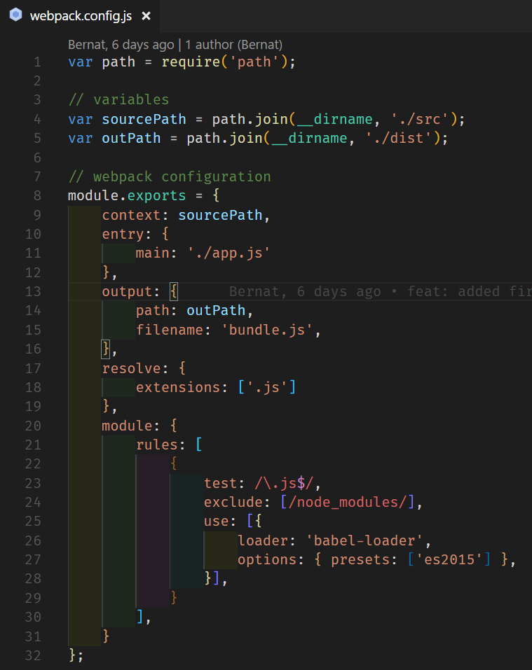
The webpack configuration
Application entry point
Bundled file
Transpilation

Slide 12
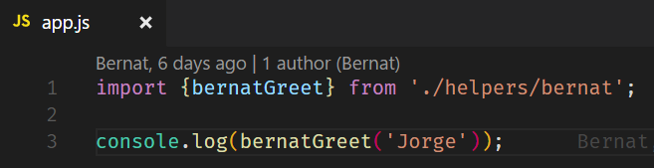
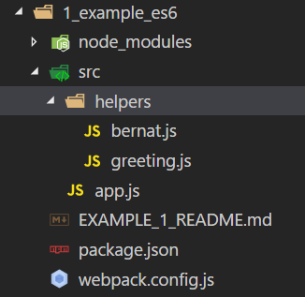
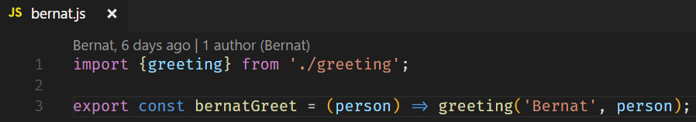
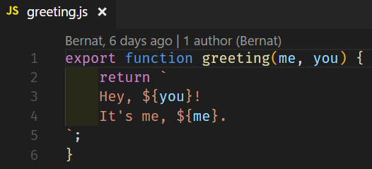
Our –most– simple application

Slide 13
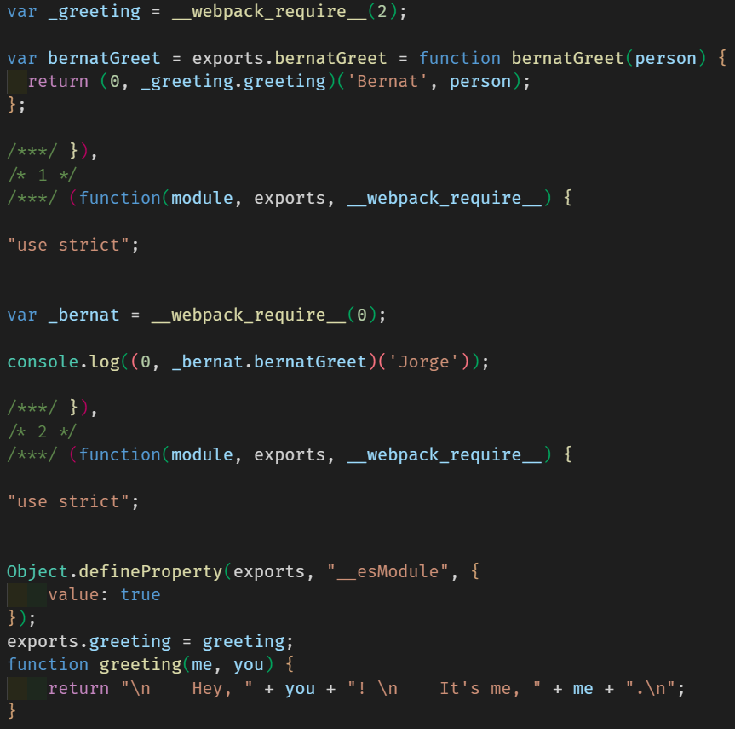
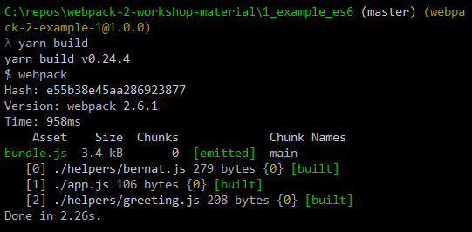


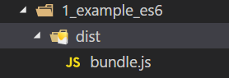
If we run our build script…

Slide 14
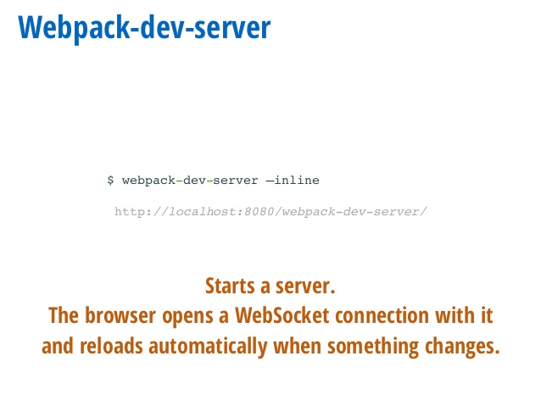

Example 2
CSS

Slide 15

Example 3
Modules and Sourcemaps

Slide 16

Example 4
Linting and testing

Slide 17
Other cool features
Tree-shaking
Hot-reloading
Continuous integration
Typescript (or other supersets)
Dedupe
Uglify
Image optimization
Cache invalidation

Slide 18
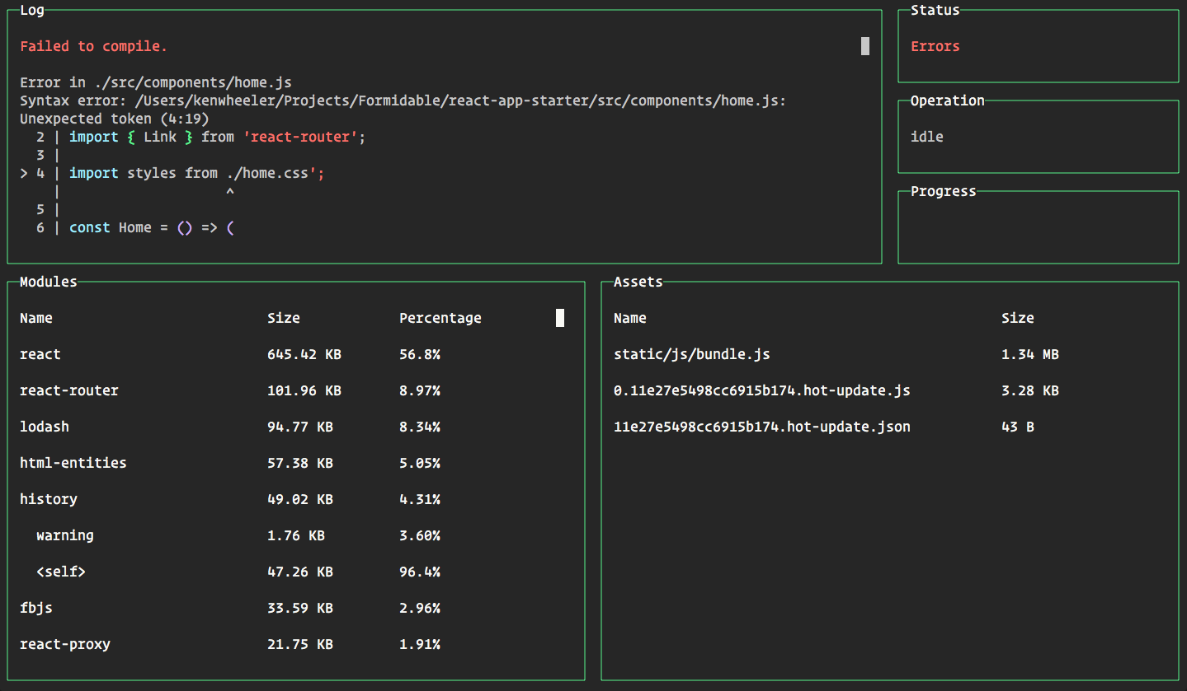
Dahsboard

Slide 19
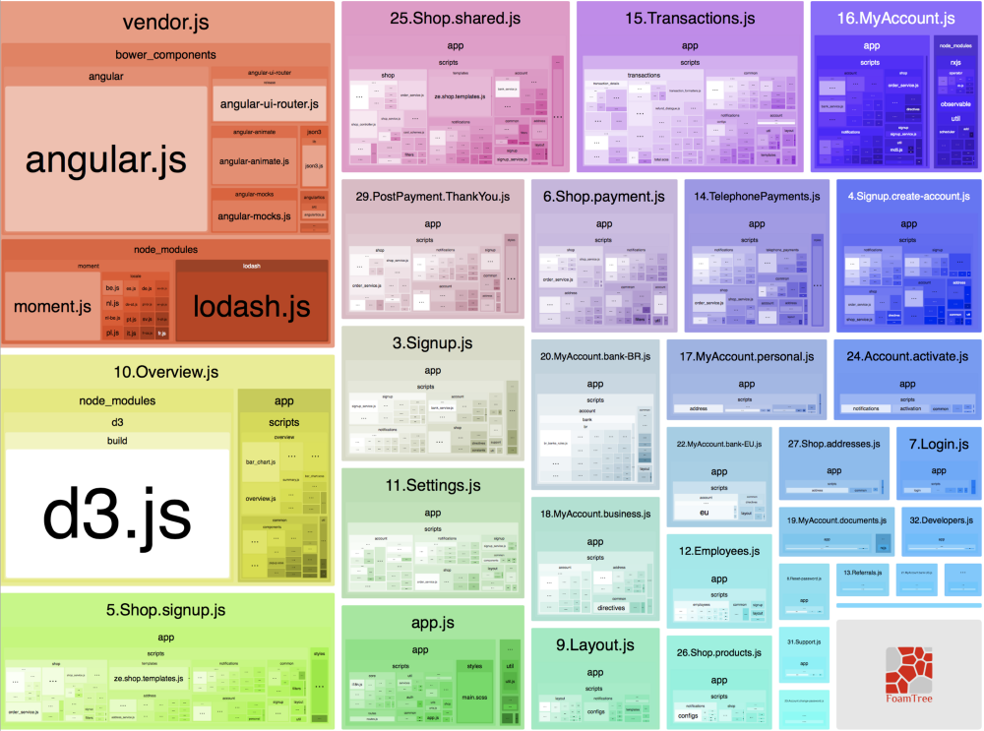
Module analysis

